Slide 1
Analysis of Granting Patterns of
Foundations Across the Southwest
By: Ankit Basu and Archit Gupta
Supervised By: Dr. William Brown
Professor, Director of the Center for Nonprofits and Philanthropy

Slide 2
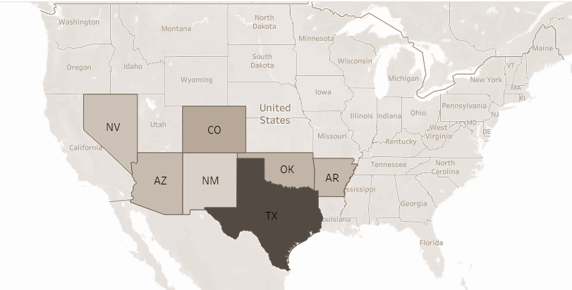
INTRODUCTION
This project aims to provide deep insight into the patterns and behaviour of grants to help Dr. Brown in his mission of understanding and serving the community better.
Dr. Brown works closely with a non-profit organization Philanthropy Southwest and studies how the organizations based in the South-West region of the US make or receive donations.
The South-West region includes Arizona, Arkansas, Colorado, Nevada, New Mexico, Oklahoma, and Texas.

Slide 3
OBJECTIVES
Our Aim
Deliverables
The project’s primary objective is to uncover trends in philanthropic funding, categorize grants by purpose, and highlight key focus areas such as education, healthcare, and community development. Additionally, the project includes interactive dashboards for intuitive exploration and to aid foundations in aligning their strategies with community needs.
The deliverables of the project include the following:
Collected Data
Data Transformation Pipeline
Tableau Dashboard

Slide 4
SCOPE OF THE PROJECT
Domain Knowledge
Scope Of The Dataset
Dashboard and Analysis
The project starts from understanding the domain, how the granting institutions work, what define a non-profit organization, how are these institutes categorized, and which entities are involved the philanthropy domain.
The data we were expected to work upon should only be based in the South-West region of the US when it comes to the grant makers.
We also needed to collect census and demographic data for all the grant makers and receivers.
The analytical dashboard is largely designed on the specific requirements laid out by the sponsor, where the main focus is the receivers of the grant, and the categories of both the donors and receivers.

Slide 5
METHODOLOGY
Data Collection
Data Transformation
Collection of data from reliable sources, including IRS Form 990 filings and external public philanthropy databases.
Population and poverty data collection Census database in addition to crosswalk data.
Includes extracting relevant data from Form 990 XML files, cleaning, standardizing, and normalizing the data to handle inconsistencies and saving it in various CSV files.
Creating Dashboards
Making it Replicable
Designing intuitive and interactive dashboards to visualize trends in philanthropic funding.
Providing actionable insights based upon the requirements laid out by the sponsor.
To develop scalable data pipelines to enable integration of new data in the future.
Also, to document the processes and methodologies for easy adaptation by other teams or projects.

Slide 6
DATA COLLECTION
CANDID
FORM 990
FORM 990-PF
Candid is an data aggregation organization in the philanthropy domain.
Dataset from Candid set the structure of the dataset.
Every non-profit organization in the US needs to file the Form-990 detailing the donations they made for tax purposes.
Form 990 PF is for non-profit private foundations.
Majority of the data we collected comes from Form 990 PF.
CENSUS
NCCS CATEGORY
HUD CROSSWALKS
Data like population, poverty, income, etc. was collected from the data.census.gov website for the year 2022.
The category data for the organizations was collected from EO BMF dataset from IRS which give a NTEE code to non-profit organizations.
Crosswalk datasets were needed to map different features in different dataset, like mapping ZIP codes to Counties.

Slide 7
DATA TRANSFORMATIONS
The IRS Form 990 and 990-PF Bulk Data was stored in XML format, and the required features were extracted to create a CSV file.
HUD Crosswalk data and Business Master File (BMF) were used to classify Metropolitan and Micropolitan Areas, map ZIP codes to Counties, categorize organizations, etc.
A separate county level grant distribution dataset was created which aggregates the grants data on demographic and geographic features.
Missing data was taken care of either using multiple sources or even filling some of the values manually to make the analysis as accurate as possible.
The most difficult part was to extract the category of the organizations as an organization could be listed under multiple or without proper categorization.

Slide 8
DATA PIPELINE
Although not being part of original scope of the project, it was important for us to make the project replicable and scalable.
We created a pipeline using python which would do all the required transformations to the raw data and generate final CSV data files.
This makes the data updation process very easy as just by adding raw file to the directory and running the script will update the final dataset.
All the intermediary datasets and crosswalks are already present and any future exceptions have also been accounted for.
IRS
NCCS
Extract
Load
Transform
HUD
Raw Data
Prepared Data
CENSUS
Data Transformation Script
CSV Files

Slide 9
DASHBOARD DESIGNING
We’ve used Tableau for developing the dashboards for this project.
The first step in dashboard development was to plan all the required analysis and dividing them based on granularity and parameters.
The interactive dashboards show graphs based on Census, Demographics, Categories, and Granting Behaviour.
These dashboards have selections and toggles to select the regions and years filter charts.
We also made sure that we do not show charts and data that are either already available publicly, but to show the hidden patterns.
As part of this project, we have developed dashboards that provide information on Census, Demographic and Grantmaker statistics for the relevant grants.
Census and Grantmaker appendices are provided for added transparency.

Slide 10
FINDINGS
The largest grantmaker in the Southwest region is Texas, followed by Colorado and Oklahoma.
Nevada and New Mexico only create 6% and 1.3% grants respectively.
Total grants paid in the year 2022 declined by approximately 23% as compared to previous years.
Most of the grants generated end up in the same geographic boundary, both at State, County and CBSA levels.
Around 45.7% of the total grants are provided by Public, Societal Benefit grantmakers, making it the biggest grantmaking industry in the Southwest.
Around 93% of the total grants are generated in Metropolitan Statistical Areas and 89% of those grants end up in Metropolitan Statistical Areas.

Slide 11
IMPACT AND IMPLICATIONS
The analysis has uncovered the geographical correlation between grantmakers and recipients.
The analysis will provide deeper insight into the grantmaker and recipient relationship of southwestern states.
The analysis would assist in recognizing if the deprived regions and areas are getting the funding they need or not.
We hope that this project will ultimately bring and impact on the smaller regions which have largely been ignored up until now.

Slide 12
CHALLENGES
The biggest challenge that we faced was collecting the data for categorization of the organizations and the purpose of grant.
The Form 990 if included values for these fields were filled manually as natural language. Instead of the actual category, it contained a sentences like: “The donation has been made for research in Art and History”.
We tried to do this categorization using Language Models, but such a large dataset and made it almost impossible to do it without adding significant challenges and going out of the scope of the project.
Form 990-PFs do not require the Recipient EIN to be mentioned by the Grantmakers, causing in significant complexity in understanding the categorization for the respective recipients.

Slide 13
FUTURE SCOPE
With further collection of data for the years 2023 and 2024, Predictive Modeling can be done to predict how the granting pattern could look like for the upcoming years. This would help in making early decisions.
There are missing values in the fields containing the information about the purpose of the grant and type of organization because of this data not being publicly available. This data could be acquired from sources like Candid and it would improve the accuracy of the analysis.
Also, currently international grants data is not present and analysis upon the international donation pattern would sure result in some more interesting trends.

Slide 14
THANK YOU!
Do you have any questions?
Acknowledgements:
Dr. William Brown
Professor, Director of the Center for Nonprofits and Philanthropy
Bush School of Government & Public Service
Dr. Lan Zhou
Associate Professor, Statistics
College of Arts and Sciences

